Slide 1
Alicja Kozikowska

Slide 2



What I do in my job?
Software Developer at Thermondo
Python
Django
First semester at ReDI

Slide 3
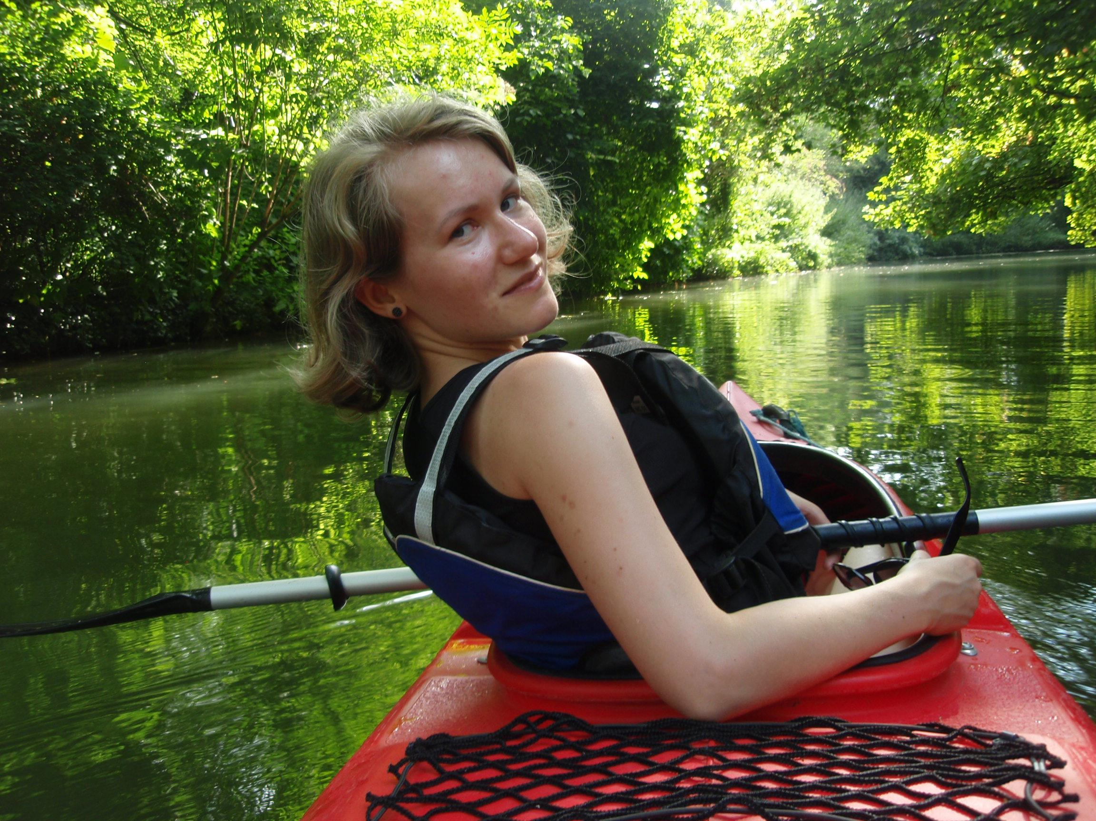
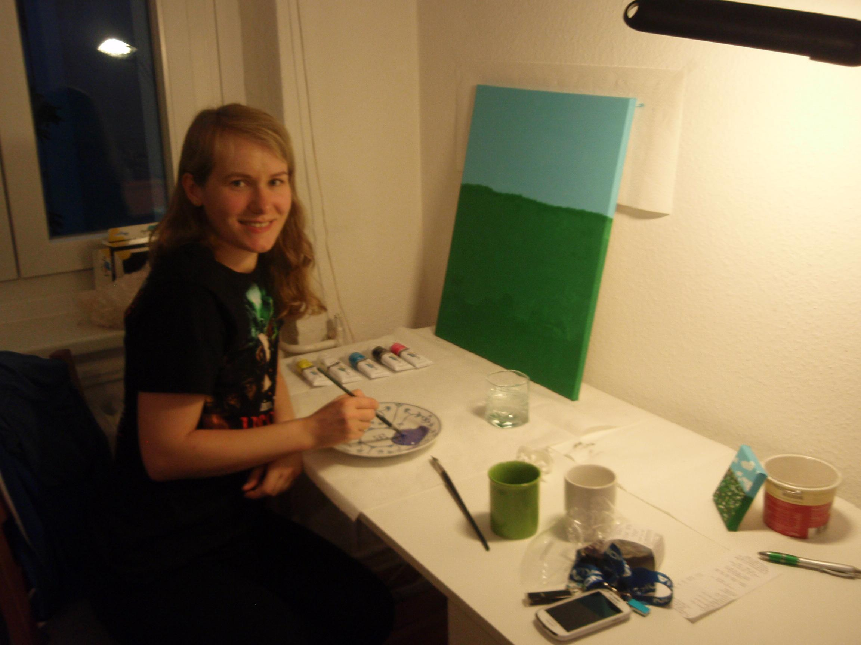
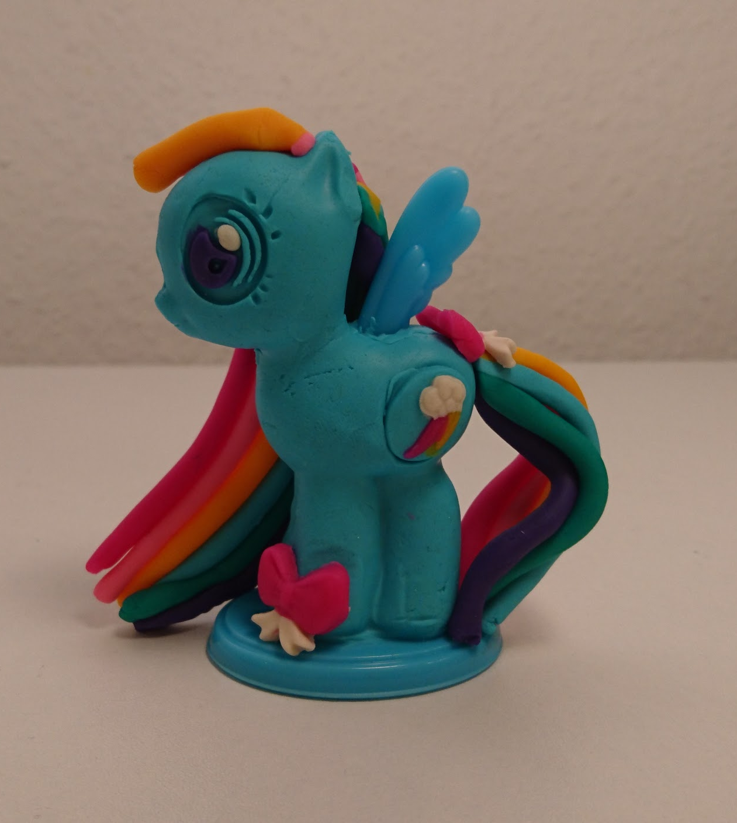
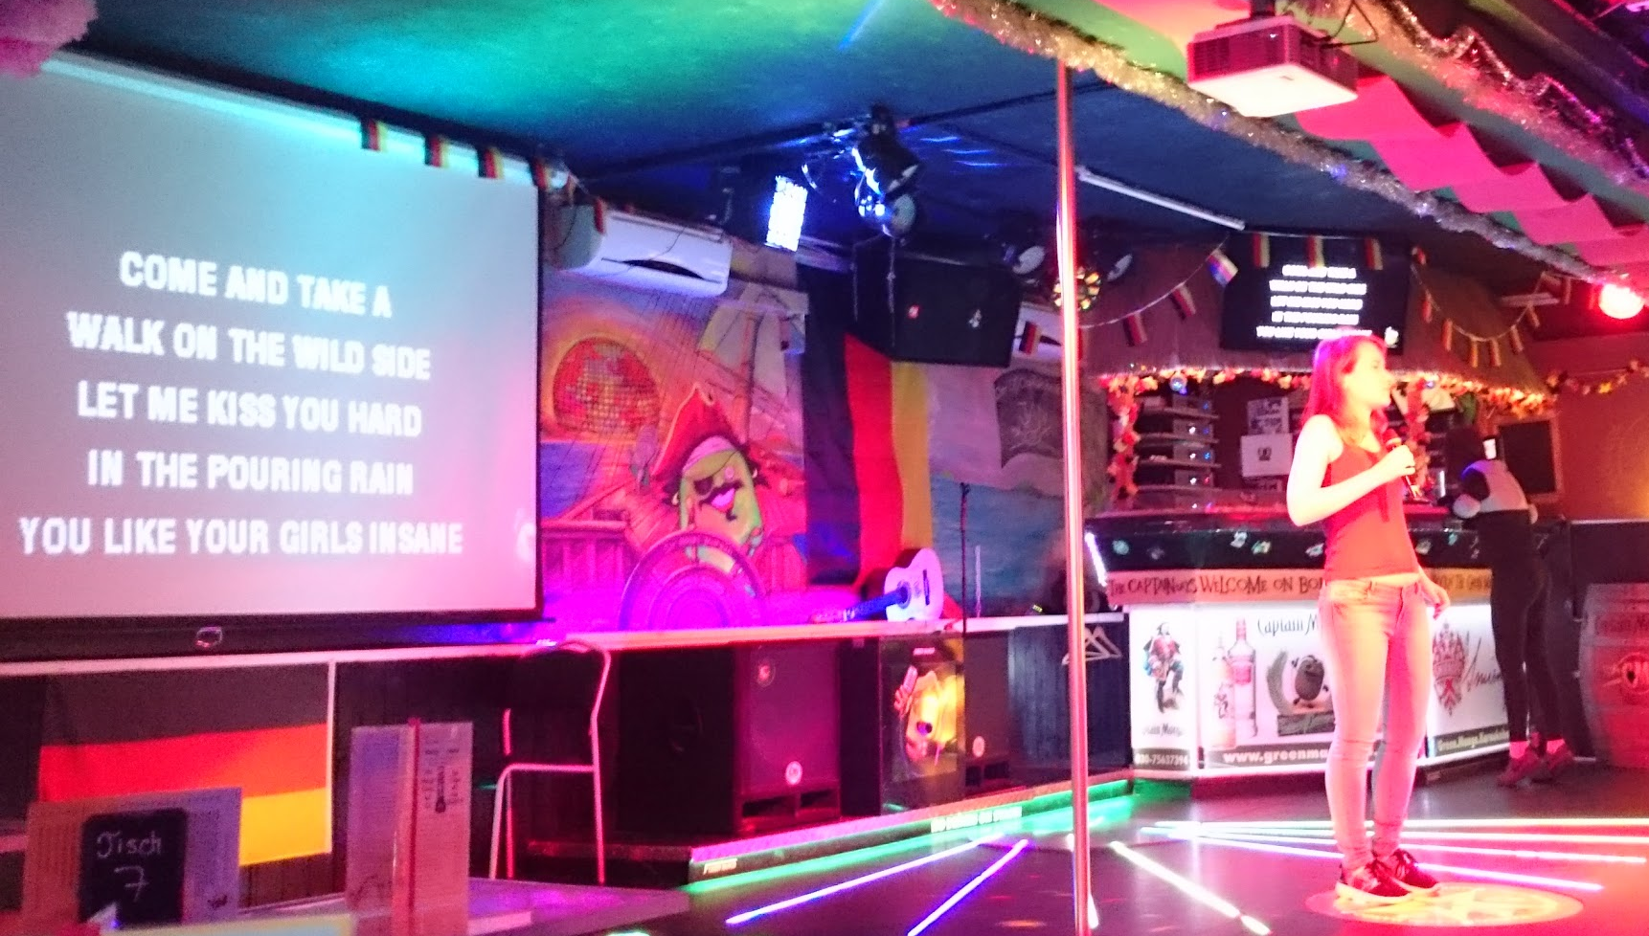
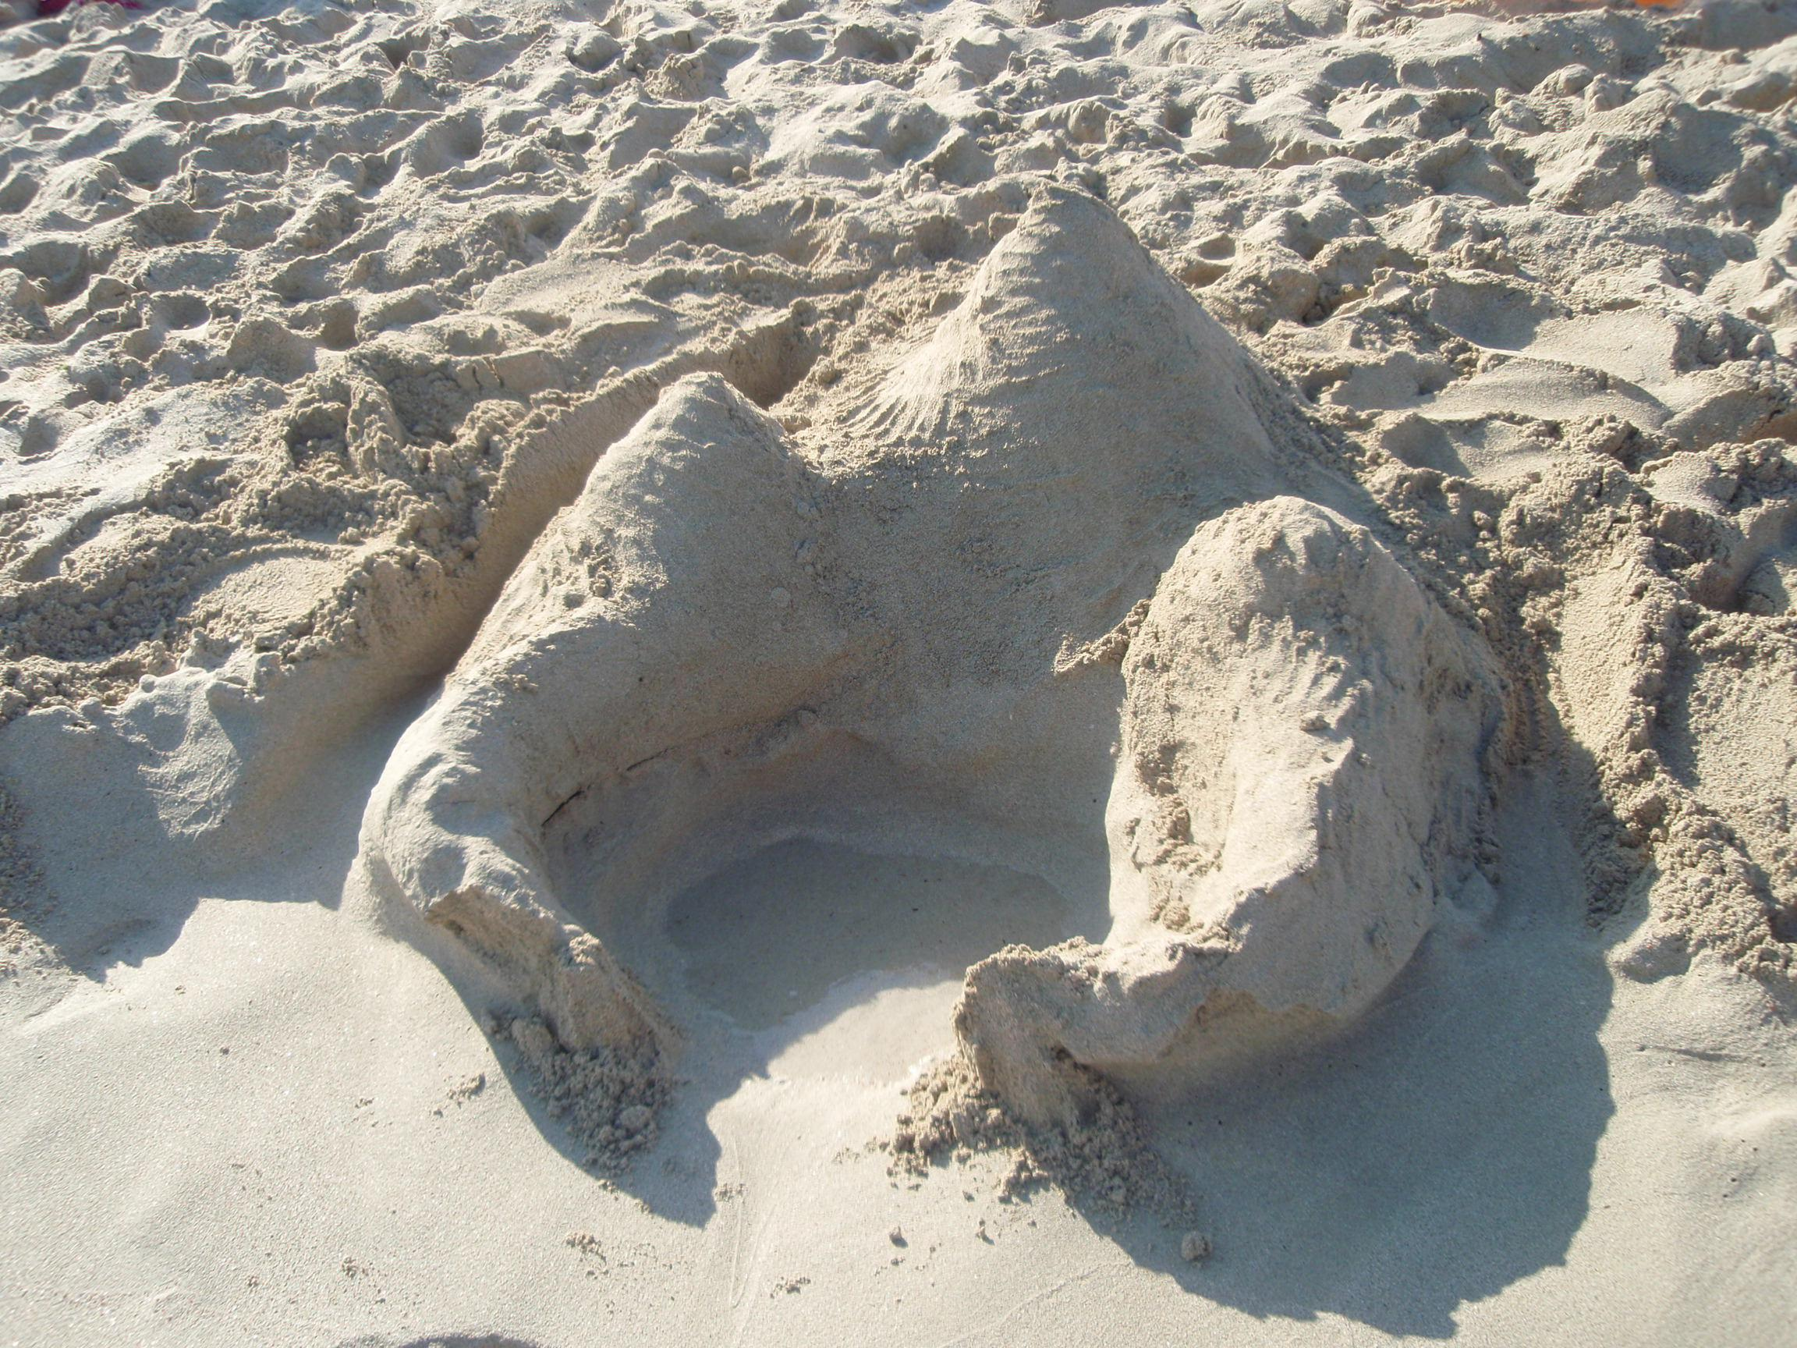
What I do in my free time?
Paintings
Ponies
Sand castles
Kayaking
Karaoke
...

Slide 4
How to contact me
email: alakozikowska@gmail.com
LinkedIn: https://www.linkedin.com/in/alicja-kozikowska/
ReDI Slack

